Slide 1
DATA PREDICTION ON HOTEL BOOKING CANCELLATION
Team Details
MEMBERS OF GROUP 2:
Mohammed Anaz
D K Tarun Venkatesh
Malini
Vishal Raj
Sangeetha Elangovan
MENTOR:
Mr. Ankush Bansal

Slide 2
Problem Statement
The objectives include improving operational efficiency, maximizing revenue, and increasing guest satisfaction.
Key focus areas involve analyzing booking trends and demand patterns, reducing booking cancellations, understanding guest preferences regarding meals and rooms, evaluating the impact of booking lead time, assessing the relationship between special requests and guest satisfaction, optimizing room allocation, examining distribution channels and marketing effectiveness, developing dynamic pricing strategies, studying parking requests in relation to booking sources, and analyzing the performance of travel agencies and companies in terms of bookings and cancellations.

Slide 3
About the dataset
Dataset Origin:
The dataset consists of approximately 1,20,000 booking transactions from two different types of hotels: a city hotel located in Lisbon and a resort hotel located in Algarve.
Time Period:
The dataset covers a time period from July 1, 2015, to August 31, 2017, providing two years' worth of booking data.
Hotel Types:
It includes data from two different types of hotels:
City Hotel: This represents a hotel located in an urban setting, specifically in Lisbon.
Resort Hotel: This represents a hotel located in a resort area, specifically in Algarve.
Data Categories:
Booking Information: Hotel Type, Cancellation, Lead Time, Arrival Date, and Length of Stay.
Guest Details: Demographics, Meal Options, Booking Channels, and Guest History.
Room & Booking Details: Room Types, Modifications, Deposit Type, and Agent Information.

Slide 4
About the dataset
S.No | Variable Name | Description | Type
1 | hotel | Resort hotel or city hotel | object
2 | is_canceled | Indicates if the booking is cancelled or not | int64
3 | Lead_time | No. Of days that elapsed between the entering date of the booking and arrival date | int64
4 | Arrival_date_year | Year of arrival date | int64
5 | Arrival_date_month | Month of arrival date | object
6 | Arrival_date_week_number | Week number of the year of arrival date | int64
7 | Arrival_date_day_of_month | Day of arrival date | int64
8 | Stays_in_weekend_nights | No of weekend nights (saturday or sunday). The guest stayed or booked to stay at the hotel | int64
9 | Stays_in_week_nights | No of weeknights (monday to friday). The guests stayed or booked to stay at the hotel | int64
10 | adults | No of adults | int64
11 | children | No of children | float64
12 | babies | No of babies | int64
13 | meal | Type of meal booked | object
14 | country | Country of origin | object
15 | Market_segment | Method of booking | object
16 | Distribution_channel | Bookings distributed through | object
17 | Is_repeated_guest | Is the booking guest has already visited or not | int64
18 | Previous_cancellations | No of previous booking that are cancelled by the customer | int64
19 | Previous_bookings_not_cancelled | No of previous booking that are not cancelled by the customer | int64
20 | Reserved_room_type | Room type reserved by the customer at the time of booking | object
21 | Assigned_room_type | Room type given to the customer | object

Slide 5
About the dataset
S.No | Variable Name | Description | Type
22 | Booking_changes | No of changes made from the moment of booking initiated | int64
23 | Deposit_type | Indicates wheather the customer made any deposits upon the booking | object
24 | agent | Agent ID | float64
25 | company | Company ID | float64
26 | Days_in_waiting_list | No of days the booking was in WL before confirmed to customer | int64
27 | Customer_type | Type of customer booked | object
28 | adr | Average daily rate as defined by dividing the sum of all lodging transactions by the total number of staying nights | float64
29 | Required_car_parking_spaces | Wheather customer required car parking | int64
30 | Total_of_special_request | No of special request made by the customer | int64
31 | Reservation_status | Reservation status of booking | object
32 | Reservation_status_date | The date at which the reservation is made | object
Total Observations | 119390
Variables | 32
Number of Numeric columns | 20
Number of Categorical columns | 12
int64 | 16
float64 | 4
object | 12

Slide 6
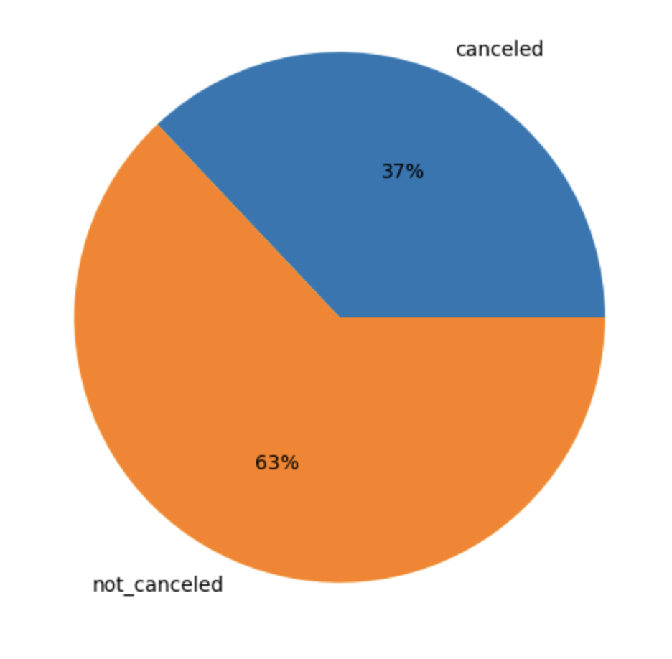
About the dataset –
Missing Values & Redundant Columns
Variable Name | Number of missing values | Percentage of missing values | Imputation Method
children | 4 | 0.003 | Median
country | 488 | 0.40 | Mode
agent | 16340 | 13.6 | Mode
company | 112593 | 94.3 | Drop
The variables Is_canceled & Reservation_status Both the variables have same kind of information hence we are dropping Reservation_status
Is_canceled | Count of classes | Percentage of classes
0 | 75166 | 62.95
1 | 44224 | 37.04
Here 0 represents no cancellation and 1 represents booking cancelled / No show

Slide 7
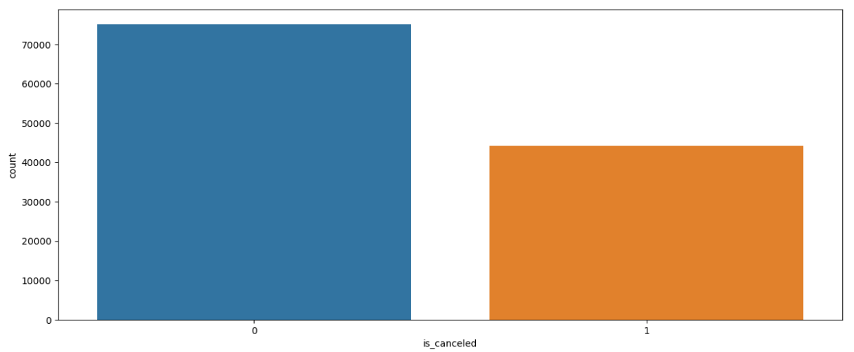
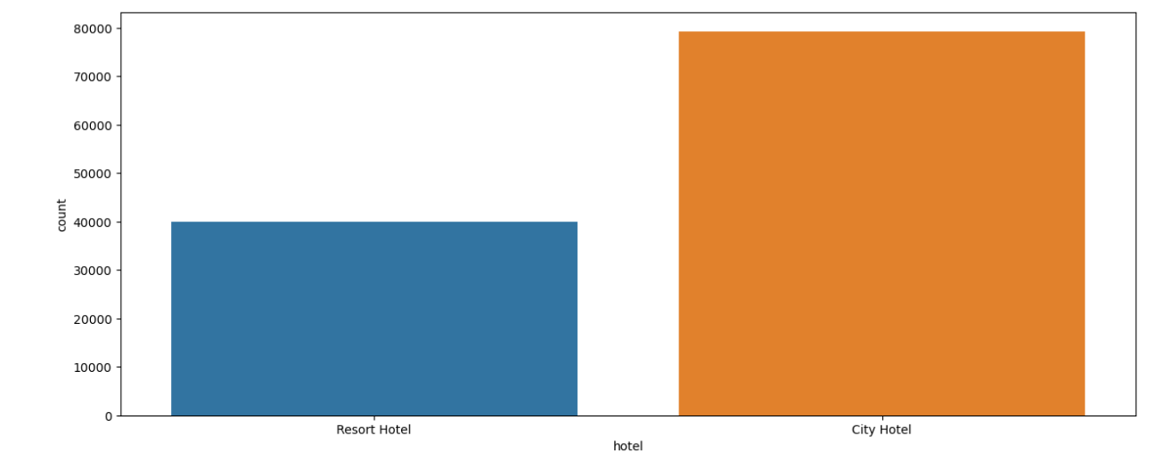

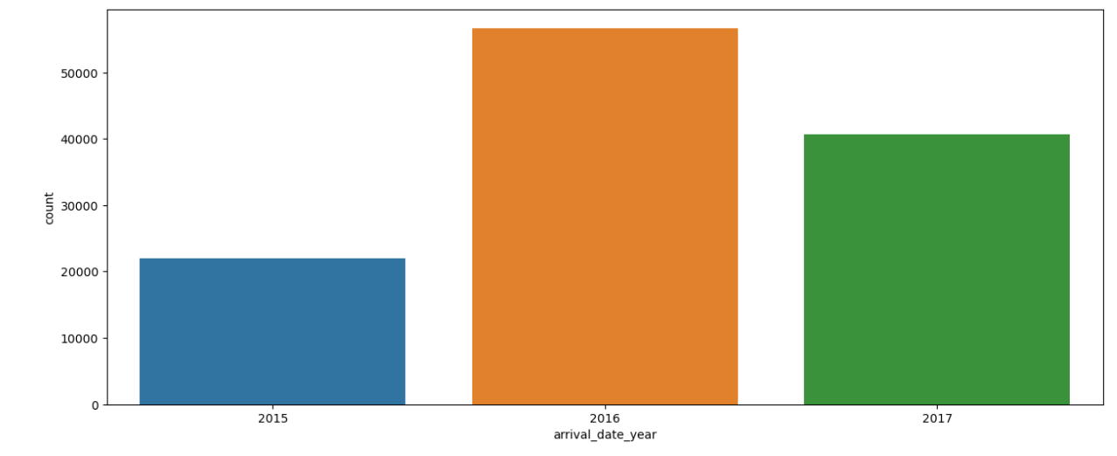
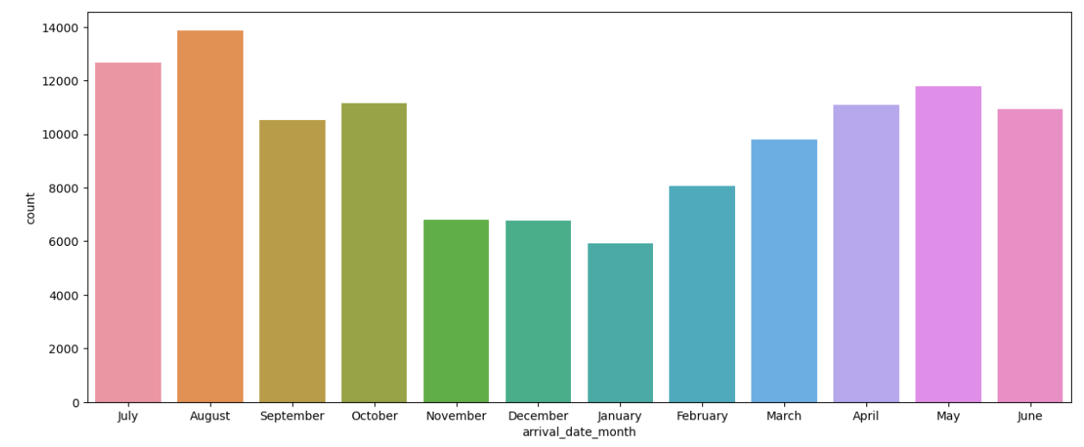
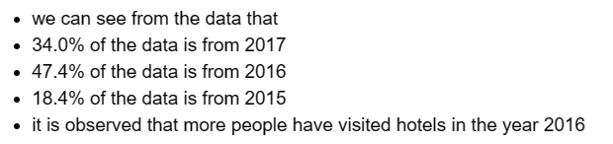

Exploratory Data Analysis –
Univariate Analysis
‘is_canceled’ variable
‘hotel’ Variable
‘arrival_date_year’ Variable
‘arrival_date_month’ Variable

Slide 8
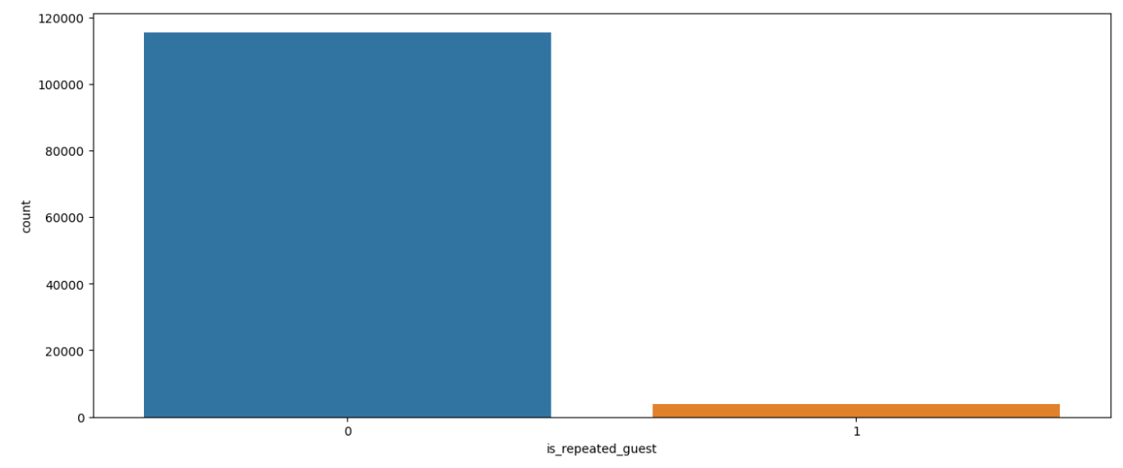
Exploratory Data Analysis –
Univariate Analysis
‘market_segment’ Variable
‘country’ Variable
Online TA | 47.304632
Offline TA/TO | 20.285619
Groups | 16.593517
Direct | 10.558673
Corporate | 4.435045
Complementary | 0.622330
Aviation | 0.198509
Undefined | 0.001675
Major Class in the ‘country’ variable | Abbreviation | Percentage of counts
PRT | Portugal | 41.107295
GBR | Great Britain | 10.159142
FRA | France | 8.723511
ESP | Spain | 7.176480
DEU | Germany | 6.103526
47 percent of the people have booked through online travel agency
We can see that the maximum number of bookings occurred from Portugal, followed by Great Britain
‘is_repeated_guest’ Variable
Here there are only few repeated guest booked the hotel 96.80% of people appearing are not repeated guest

Slide 9
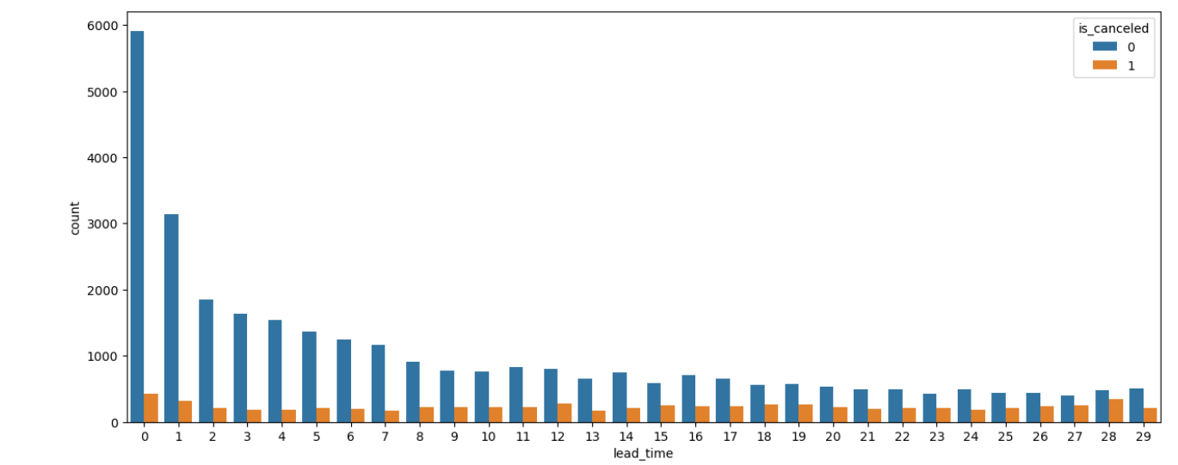
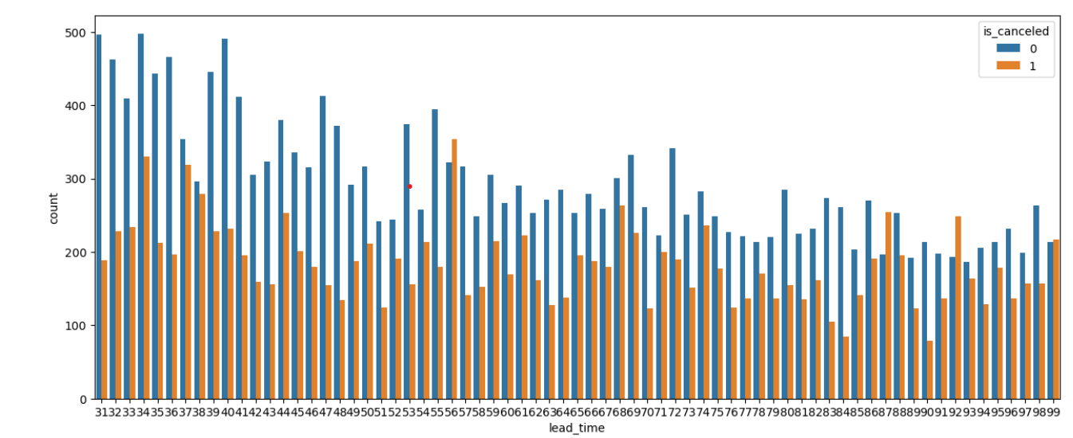
Exploratory Data Analysis –
Bivariate Analysis
‘Lead_time’ vs ‘is_canceled variable
When the lead time increases the cancellations also increases

Slide 10
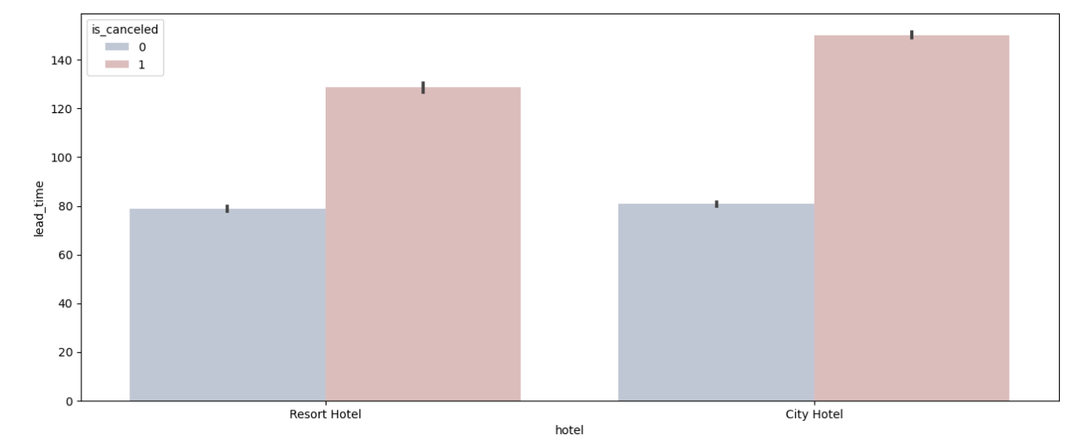
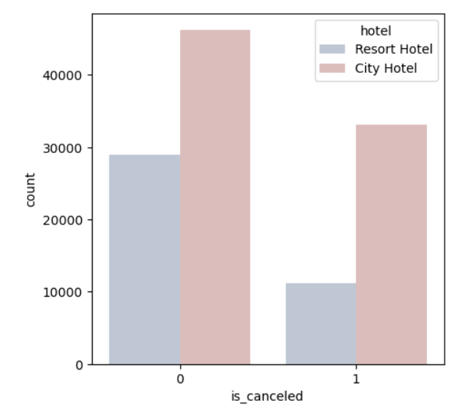
Exploratory Data Analysis –
Bivariate Analysis
‘hotel’ Vs ‘lead_time’ variable
In both the hotels the bookings with more than lead time of 60 have higher chances of cancellations
‘hotel’ Vs ‘is_canceled’ variable
In the cancelled bookings we can see that more number of cancellations occurred at city hotel

Slide 11
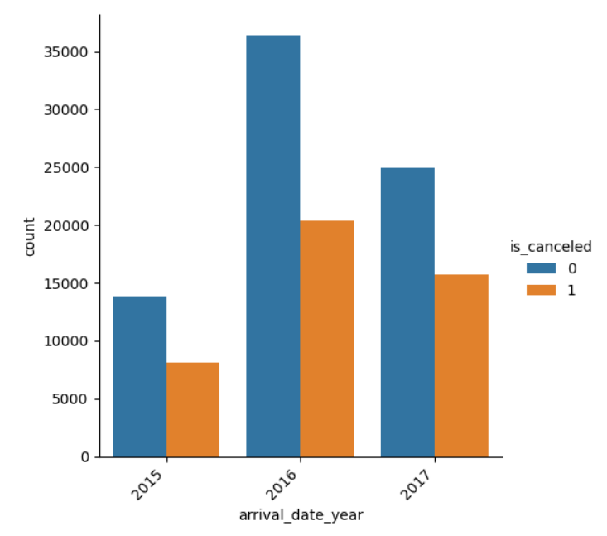
Exploratory Data Analysis –
Bivariate Analysis
Maximum booking occured in a year
‘arrival_date_year’ Vs ‘is_canceled’ variable

Slide 12
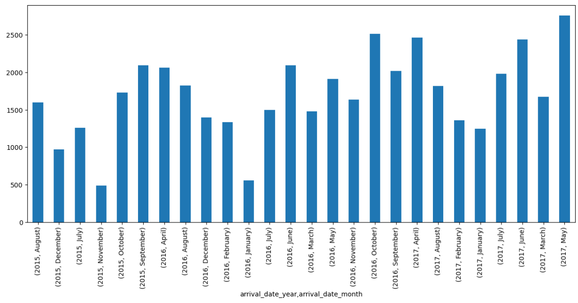
Exploratory Data Analysis –
Multivariate Analysis
Month in every year with most cancelations
arrival_date_year' Vs 'arrival_date_month' Vs 'is_canceled‘ variables

Slide 13
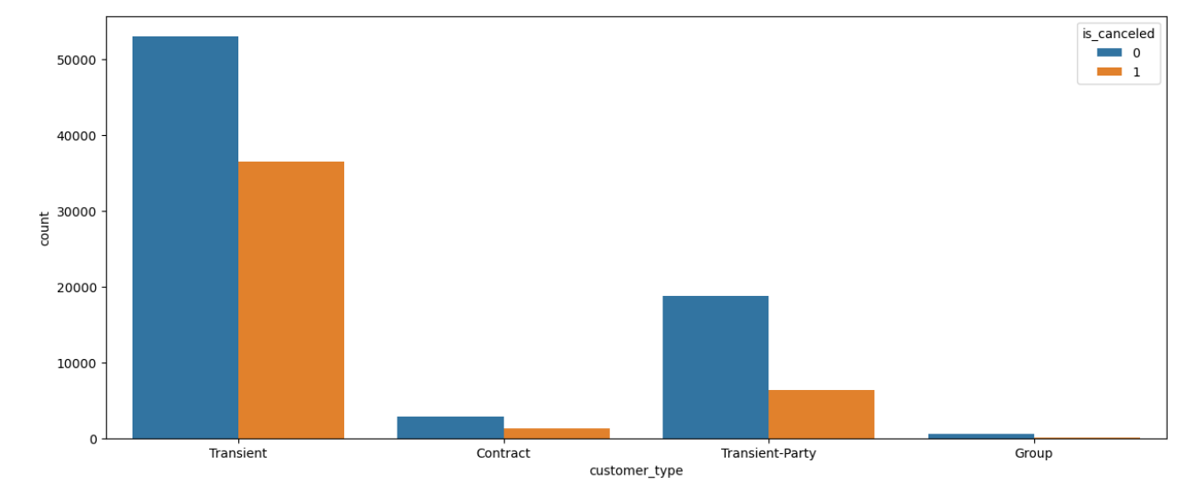
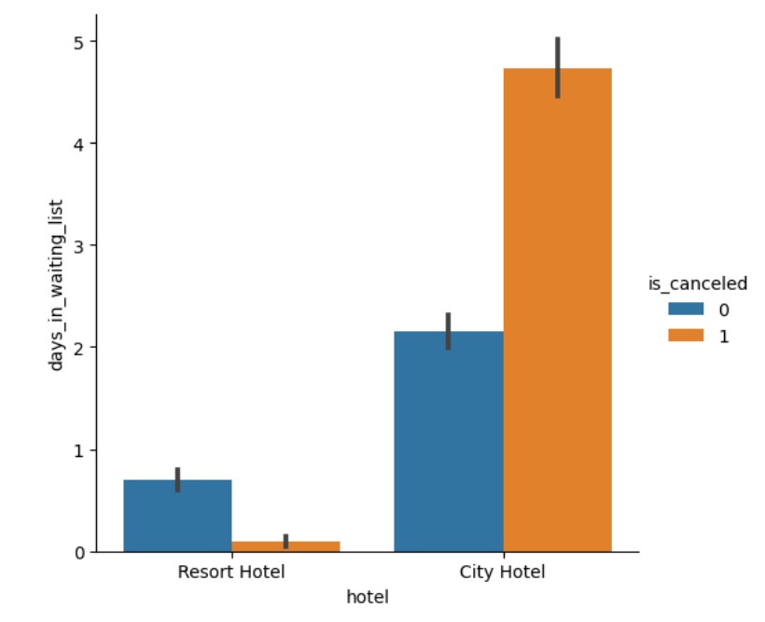

Slide 14
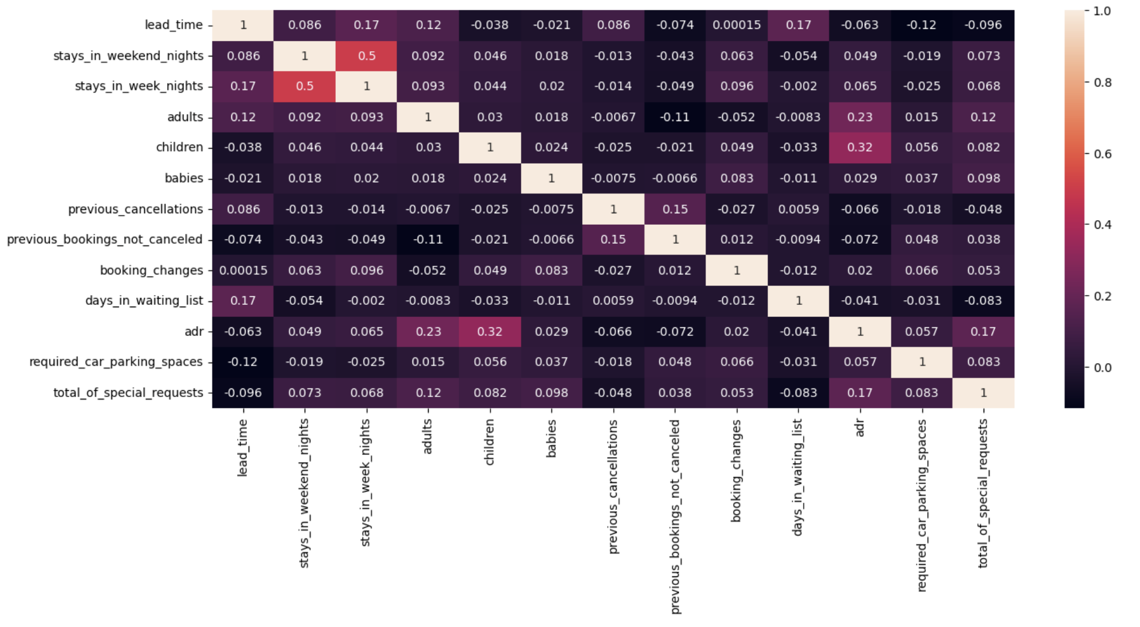
Check for Multicollinearity
We can observe that there is no significant multicollinearity among the variables, which is a positive aspect to consider during our model building process and there is moderate correlation between the independent variables and Target variable

Slide 15
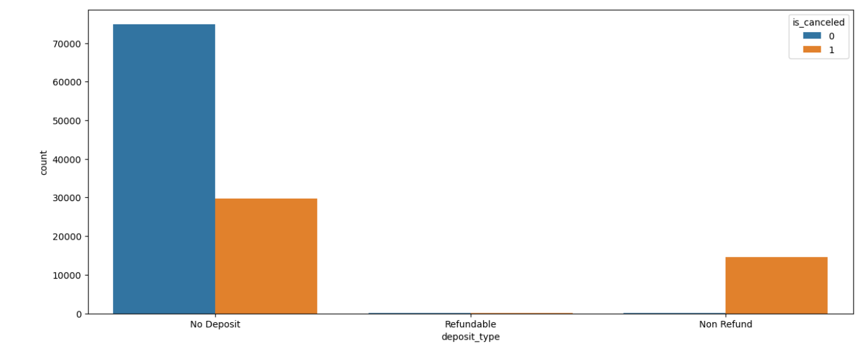
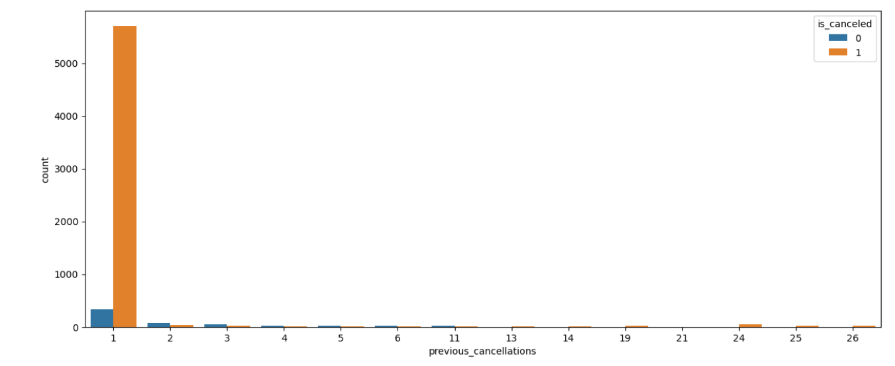
We can see that the bookings with no deposits have the highest cancellation rate
The ‘Non-Refundable’ bookings tend to cancel at a higher rate compared to the people who don’t cancel

Slide 16
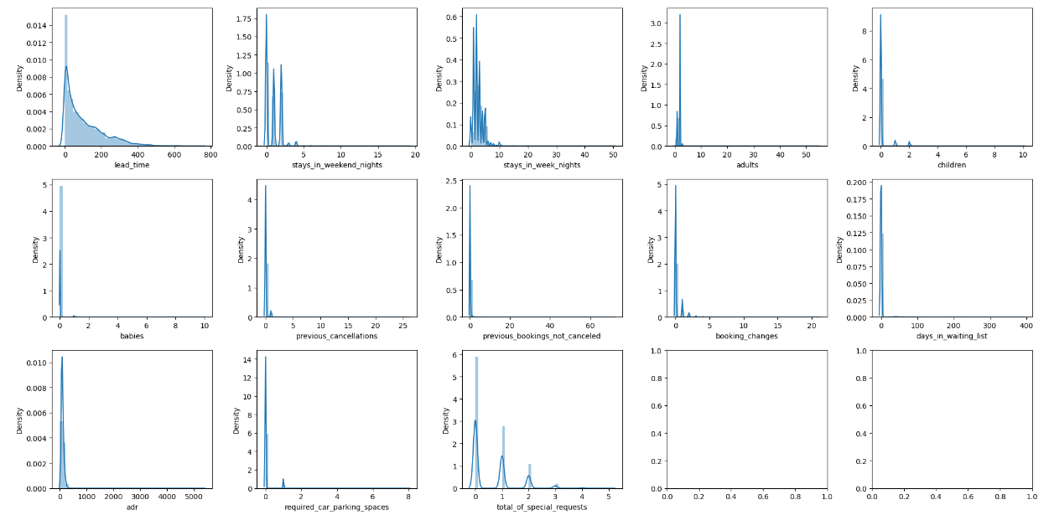
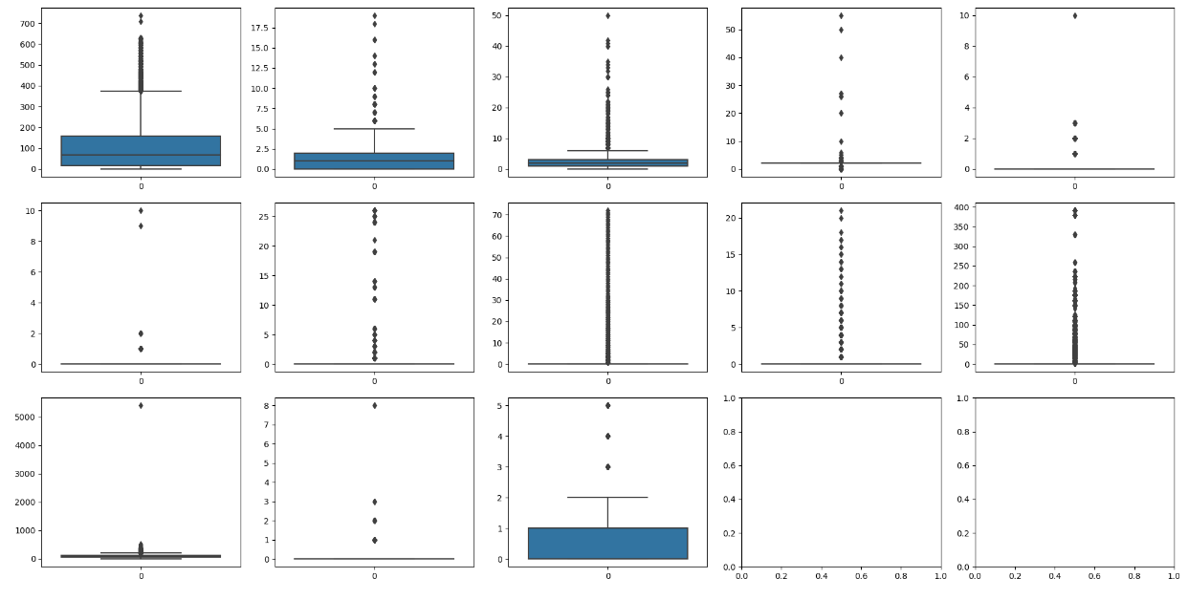
Exploratory Data Analysis –
Outlier Detection
The data exhibits a slight right-skew, as evident from the distribution plots. Notably, the presence of numerous data points exceeding the upper whisker
Boundary strongly suggests the existence of outliers within the dataset

Slide 17
Data Processing – Removing Outliers
In the data preprocessing phase, we applied a visualization technique to assess the presence of substantial skewness in our dataset. Skewed data distributions can have a significant impact on the performance of our analytical models. This visual representation allowed us to observe the shape of the data distribution for each feature. From these distributions, we can observe that the data exhibits pronounced skewness, indicating that further attention to address this skewness may be necessary for our data preprocessing efforts.

Slide 18
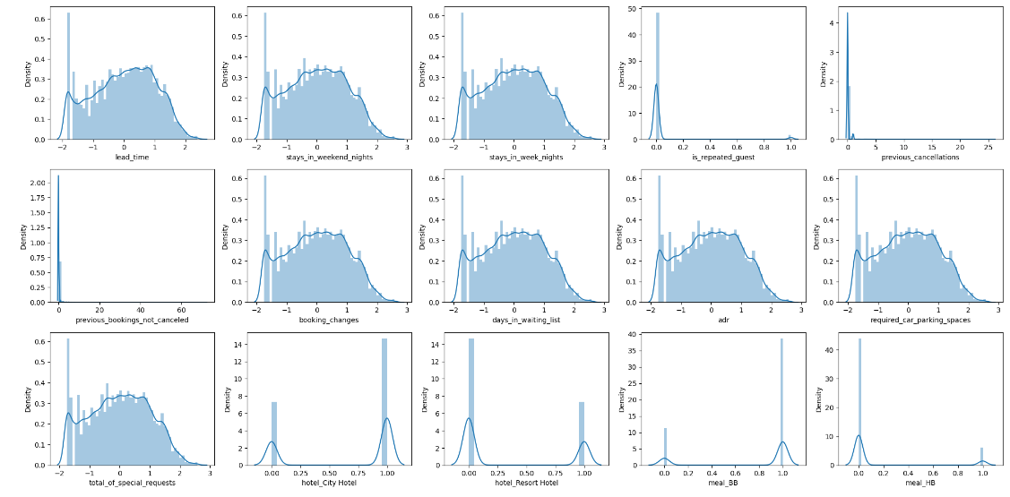
Data Processing – Transformation
Consistently applying these transformations to both datasets enhance our model's reliability when making predictions on new, unseen data. This strengthens our model's ability to generalize and make dependable predictions, bolstering our machine learning solution's overall robustness.

Slide 19
Feature Engineering
Family Size Categorization
To better capture the dynamics of guests traveling with children, babies, or family members, we created a consolidated column called "Family." This column was further segmented into three categories - small, medium, and large-sized families based on the number of accompanying family members. This allows us to account for the varying needs and preferences of different family sizes during their stay.
Agent Booking Tiers
Agents responsible for bookings were classified into three distinct groups based on their booking volume. This segmentation helped us identify the contributions of different agent tiers to overall bookings and guest satisfaction. It also informs our strategy for agent incentives and management.
Room Preference Analysis
To gain a deeper insight into room allocation satisfaction, we combined the "reserved room type" and "assigned room type" columns into a single feature called "Room Type." This feature indicates whether guests received their preferred room type or not, providing valuable information on guest satisfaction and potential room allocation issues.

Slide 20
Feature Engineering
Geographic Clustering of Countries
We grouped countries based on their respective continents. This geographic categorization enables us to identify trends and preferences among guests from specific regions and tailor services or marketing strategies accordingly. It also simplifies the analysis of regional performance.
Holiday Identification
By analyzing reservation status dates, we categorized bookings as either holidays or non-holidays. This distinction allows us to account for the impact of holidays on booking patterns, occupancy rates, and guest behavior, enabling us to optimize staffing and services during peak holiday periods.
Seasonal Arrival Date
We transformed the "Arrival date month" feature into a more intuitive representation by associating each month with a specific season. For instance, if a reservation falls in December, it is categorized as winter. This simplifies the understanding of booking patterns and helps us make season-specific recommendations or adjustments.

Slide 21
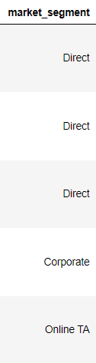
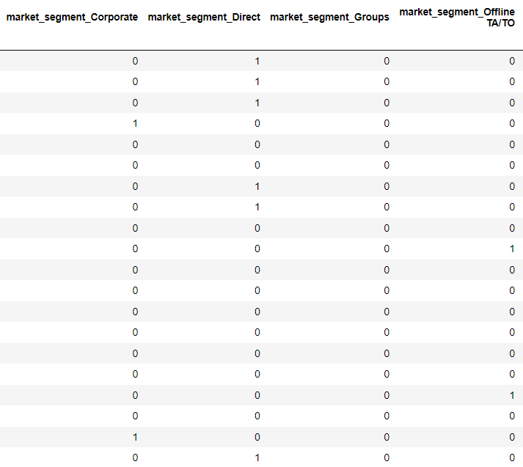
Data Processing – Encoding
We applied dummy encoding using the 'get_dummies' method from Pandas to convert categorical features into binary columns.
This transformation prepares the data for machine learning by ensuring that the model can interpret and use categorical information correctly during training, without introducing any unintended ordinal relationships.

Slide 22
Model Building
For the modeling phase, we opted to utilize a Logistic Regression classifier from the Scikit-Learn library as our base model. This choice was based on its suitability for our classification task and its interpretability, making it a solid starting point for our analysis.
 | Precision | Recall | F1 score | Support
0 | 0.84 | 0.91 | 0.87 | 22654
1 | 0.82 | 0.70 | 0.75 | 13163
Accuracy |  |  | 0.83 | 35817
Macro avg | 0.83 | 0.80 | 0.81 | 35817
Weighted avg | 0.83 | 0.83 | 0.83 | 35817

Slide 23
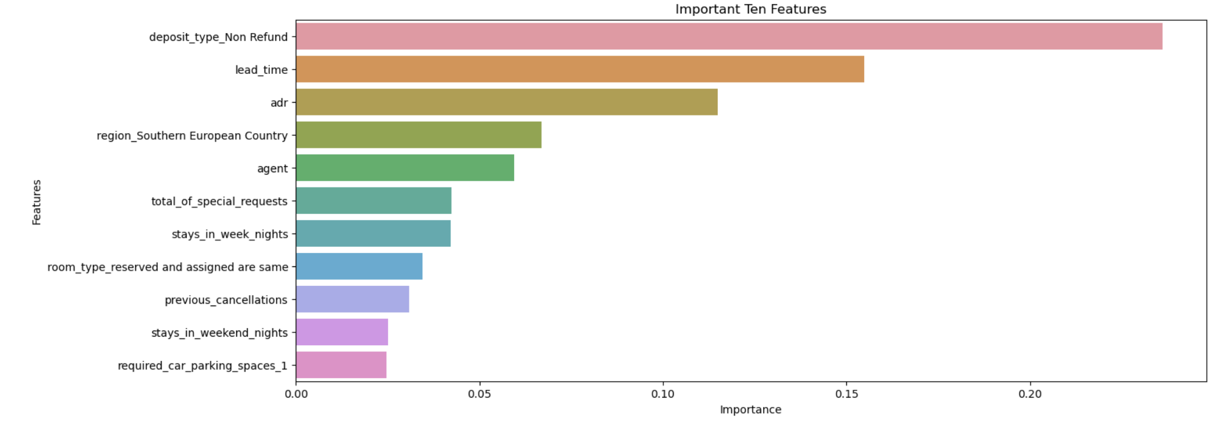
Feature Selection
Selecting the Important features from the features
We used decision tree feature importance to identify crucial attributes and applied them across various models to boost predictive accuracy and data-driven decision-making.

Slide 24
Model Building
After building the Base model which gave us a good understanding of how our model performs and we decided to proceed further to improve the performance of the model through Hyper tuning the models
Hyper Tuning
By training a model with existing data, we are able to fit the model parameters.
However, there is another kind of parameter, known as Hyper parameters, that cannot be directly learned from the regular training process. They are usually fixed before the actual training process begins. These parameters express important properties of the model such as its complexity or how fast it should learn.
GridSearchCV
In GridSearchCV approach, the machine learning model is evaluated for a range of hyper parameter values. This approach is called GridSearchCV, because it searches for the best set of hyper parameters from a grid of hyper parameters values.

Slide 25
Model Building
Grid Search CV for KNN Model
N_Neighbors | 3,5,7
P | 1,2
Best Params for KNN Model
N_Neighbors | 7
P | 1
Grid Search CV for Decision Tree Model
Criterion | Entropy, Gini
Max Depth | 3,5,7
Best Params for Decision Tree Model
Criterion | Gini
Max Depth | 7

Slide 26
Model Building
Grid Search CV for Random Forest Model
Criterion | Entropy, Gini
Max Depth | 10,15
Max Features | Sqrt, log2
Min Samples split | 2,8
Min Samples Leaf | 5,9
Max leaf nodes | 8,11
N_estimators | 100
Best Params for Random Forest Model
Criterion | Gini
Max Depth | 10
Max Features | Sqrt
Min Samples split | 2
Min Samples Leaf | 9
Max leaf nodes | 11
N_estimators | 100

Slide 27
Model Building
S.no. | Model | Accuracy | Recall | Precision | F1 Score
1 | Base Model | 0.831895 | 0.695054 | 0.820097 | 0.752416
2 | KNN Model with Feature Selection | 0.851104 | 0.775203 | 0.811258 | 0.792821
3 | Decision Tree model with feature selection | 0.816205 | 0.582390 | 0.875914 | 0.699612
4 | Random Forest model with feature selection | 0.795293 | 0.466687 | 0.951665 | 0.626262
5 | Bagging using KNN with feature selection | 0.852751 | 0.776723 | 0.814078 | 0.794962
6 | Bagging using DT with Feature selection | 0.876288 | 0.791461 | 0.860707 | 0.824633
7 | Stacking using lr,knn,dt with Feature selection | 0.872882 | 0.790929 | 0.852522 | 0.820571
8 | Ada boost with random forest and feature selection | 0.8811118 | 0.785535 | 0.878132 | 0.829257
9 | Gradient boost with Feature Selection | 0.866711 | 0.783560 | 0.842716 | 0.812062
10 | Extreme gradient boost with feature Selection | 0.872658 | 0.791385 | 0.851619 | 0.820398

Slide 28
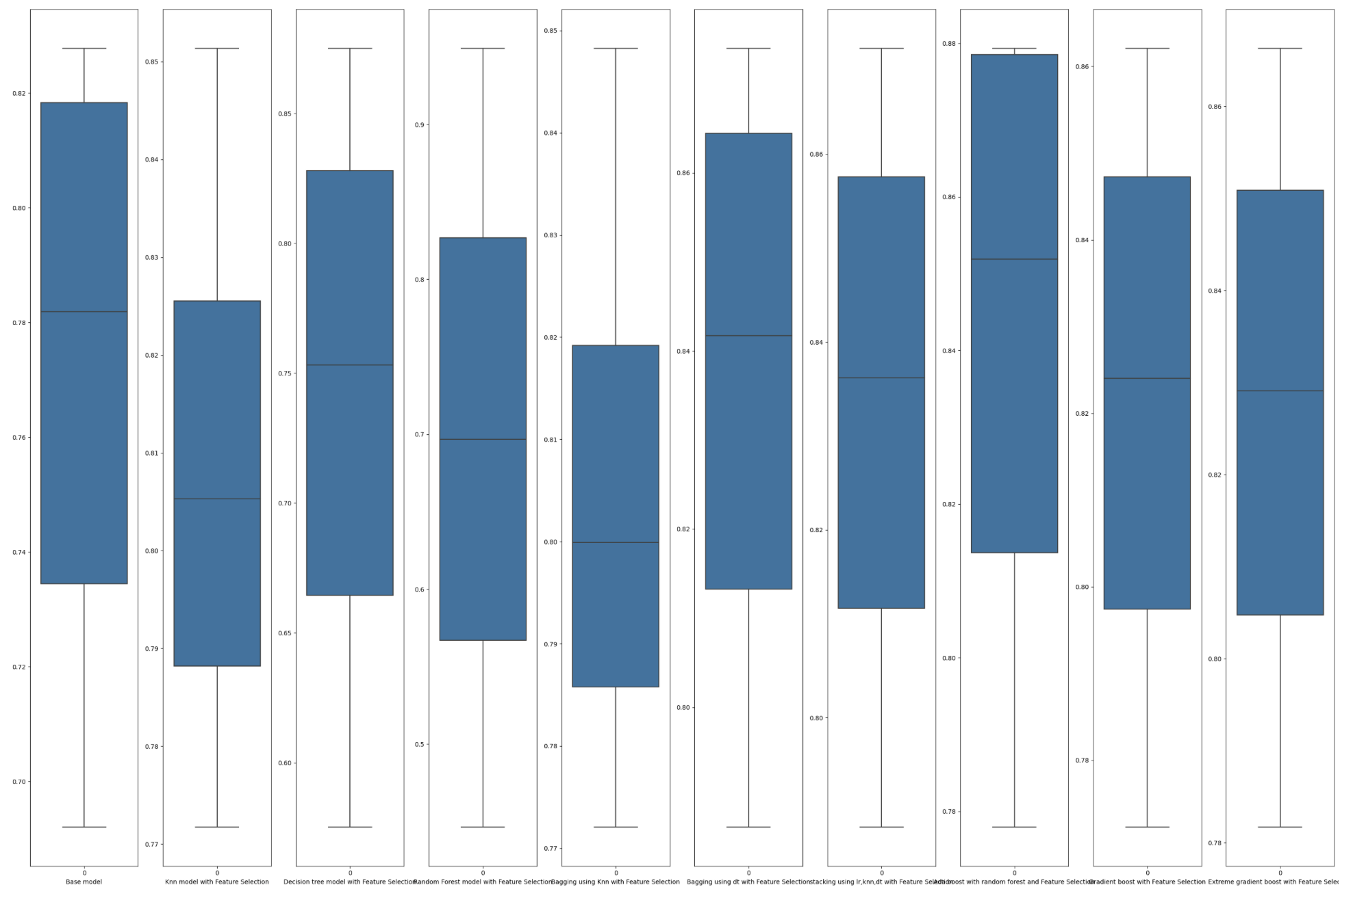
Model Building - Subplot
We're using box plot to select model which has highest Average scores between each models.

Slide 29
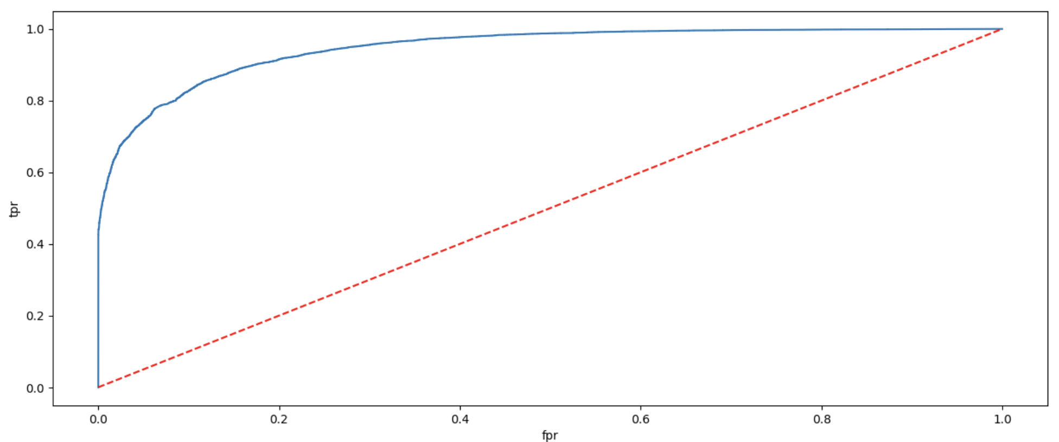
Model Building – ROC curve
The ROC score of Ada boosted Random forest model is 0.94672

Slide 30
Business Understanding & Interpretation
During the time of year when there is a radical number of bookings due to holidays and events this model will help us determine if the customer who booked the rooms will show up (pay for the rooms after stay) at these peak seasons or the reserved rooms would not bring in revenue.
The model is about analyzing a dataset that contains two distinct hotels namely “city hotels” and “resort hotels”, The primary objective is to find whether the person who booked hotel rooms, checked in or cancelled the booking. The challenge is significant for hotel management as it helps in determining the status during the period of booking and helps to manage their resources effectively and enhance their operations
Which variables are significant in predicting the bookings of customer will be cancelled or not? The significant variables are:
deposit_type_Non Refund - The Customers with non refundable deposit type.
lead_time - No. Of days that elapsed between the entering date of the booking and arrival date
adr - Average daily rate as defined by dividing the sum of all lodging transactions by the total number of staying nights
region_Southern European Country - Locations of customers from Countries in Southern European Region
agent - the number of bookings done by an Agent
stays_in_week_nights - No of weekend nights (Saturday or Sunday). The guest stayed or booked to stay at the hotel

Slide 31
Conclusion
In this project, we aimed to develop and evaluate supervised classification models to predict whether customers who book hotel rooms will show up for their reservations. The dataset encompassed a wide range of features, offering valuable insights into the factors influencing no-shows. We employed various machine learning algorithms and techniques to create predictive models. After extensive experimentation, we achieved the highest accuracy of 88% with the AdaBoost model using random forest as the base classifier and feature selection techniques.
Model Diversity: We explored a diverse set of classification models, including linear models, k-nearest neighbors (KNN) with feature selection, decision trees, random forests, bagging using KNN feature selection, bagging using decision trees, stacking with KNN feature selection, AdaBoost with random forest as the base classifier and feature selection, gradient boosting with feature selection, and extreme gradient boosting. This diversity allowed us to compare the performance of different approaches.

Slide 32
Conclusion
Top-Performing Model: The AdaBoost model with random forest as the base classifier and feature selection techniques emerged as the best-performing model, achieving an accuracy of 88%.
Business Implications: The accurate prediction of no-shows offers substantial benefits to the hotel industry. It allows for optimized resource allocation, improved revenue management, enhanced customer experience, and operational efficiency.
Continuous Improvement: Successful deployment of the model requires ongoing monitoring and maintenance to adapt to evolving conditions and to ensure that ethical and legal standards are upheld.
In summary, this project provides a robust predictive model for the hotel industry to effectively manage reservations and resources, optimize revenue, and improve the overall customer experience. It underscores the importance of data-driven decision-making and the need for continual model improvement and ethical considerations in model deployment.

Slide 33
Thanks!
- Group 2

